Slide 1











Presentation
Columbia
Asia Hospital
Analysis
Aadarsh Katiyar

Slide 2

About
Columbia Asia Hospital
A well-known healthcare facility, Columbia Asia Hospital is a shining example of patient-centered care and medical expertise. The hospital is well-known for its dedication to offering top-notch medical care and has a global presence in several nations. Modern infrastructure, state-of-the-art medical technology, and a staff of highly qualified and caring healthcare professionals define Columbia Asia. In order to address the many requirements of the communities it serves, the hospital's ethos is centered on providing complete and individualized healthcare solutions. Columbia Asia Hospital is committed to providing excellent medical care and promoting a healthy and prosperous society. It has achieved this by adopting a patient-centric approach.

Slide 3
Summary
A dataset from Columbia Asia Hospital was carefully analyzed and guaranteeing data integrity. We looked at popular departments, typical wait times, and patient groups' patterns of healthcare use. We looked at patient trends and determined many different types of aspects by using DAX functions. We looked at how wait times and satisfaction levels relate to one another, how departmental visits are affected by demographics, and how to handle discrimination complaints. We examined the General Practice department's profitability, waiting time variations, recommended discount assignment, and doctor shift alignments. We demonstrated our technical expertise in adding columns to Power Query using M-query and Power BI Gateway. The hospital's strategic decision-making, patient experience advancements, and operational improvements are informed by the insights obtained.

Slide 4


Analytical Approach and Tools
Data Transformation and Cleaning
Used Power Query Editor in Power BI to transform and clean data. Handled missing values and inconsistencies to ensure data integrity.
Power Query Editor
Used Power Query Editor to shape and clean the Data. Carried out tasks including sorting, filtering and merging to improve the quality of Dataset.
DAX Functions
Employed DAX Functions for numerical measurements, such as Average, Sum, IF, IFBlank, Calculate, Switch, Max, Count.
Visualizations
Created interactive dashboards and reports using Power BI's visualizations. Implemented charts, tables, and tabular views for effective data presentation.
Strategic Decision-Making
Helped with strategic decision-making by offering useful insights and conducting patient demographic analysis. Computed departmental revenues and average waiting times using DAX tools.

Slide 5
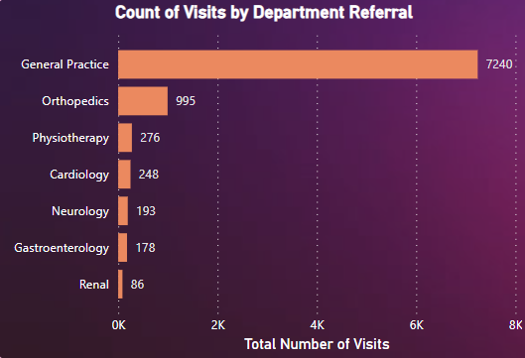
Total Visits by Department
The distribution of patient visits across the various departments can be seen in the bar chart, which makes the following visit counts visible: With 7240 visits, general practice is the most popular, followed by orthopedics (995), physiotherapy (276), cardiology (248), neurology (193), gastroenterology (178), and Renal (86). With General Practice getting the most visits and Orthopedics coming in second, this graph clearly illustrates the relative popularity of each department and offers insightful information for the hospital's resource allocation and strategic planning.

Slide 6
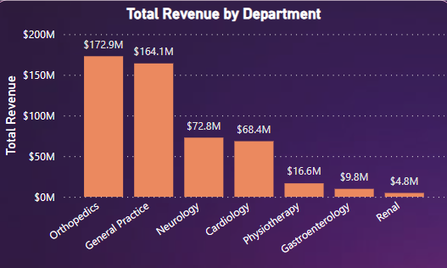

Total Revenue
Overall Revenue Earned
$509.3M
The departmental revenue appears in a column chart that highlights significant contributions. With $172.9M, Orthopedics is the largest, closely followed by General Practice at $164.1M. Contributions from cardiology and neurology are $72.8M and $68.4M, respectively. Gastroenterology, physiotherapy, and renal come next with $16.6M, $9.8M, and $4.8M, respectively. Within the hospital, this succinct depiction facilitates resource allocation and strategic decision-making.

Slide 7

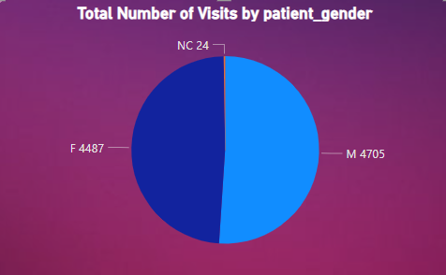

Gender Preference
The gender distribution of hospital visits appears to be equal in the pie chart, with 51.1% (4705) of hospital visits being made by men and 48.9% (4487) by women. This fair representation highlights the hospital's welcoming atmosphere that serves a wide spectrum of patients.
4705
4487

Slide 8

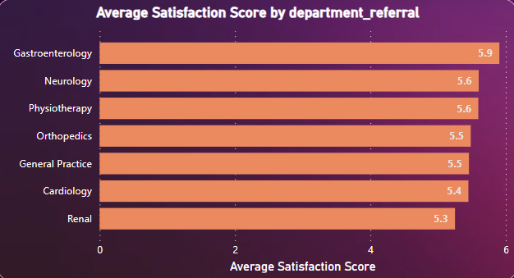
Average Satisfaction
Satisfaction Scores every departments received
Recommendations
• Gastroenterology leads with a strong 5.9 average satisfaction rating.
• Neurology and Physiotherapy follow closely at 5.6.
• Orthopedics and General Practice are slightly behind with 5.5.
• Cardiology and Renal exhibit ratings of 5.4 and 5.3, respectively.
To improve overall satisfaction, focus on enhancing ratings in Cardiology and Renal departments.
Implement targeted improvements, gather regular feedback, and foster a patient-centric culture.
Continuous efforts in addressing specific concerns will contribute to overall patient satisfaction.

Slide 9
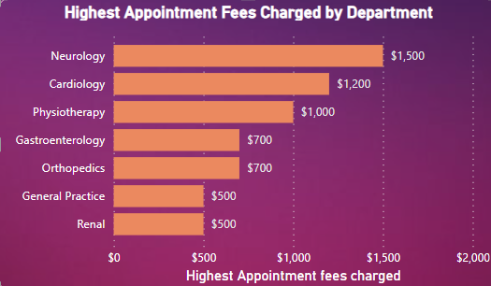

Appointment Fees
Total Doctors in Hospital
22
The appointment fees that doctors charged varied depending on the departments in which they worked.
Let's review the fees that these departments charge. The department with the highest fee of all is neurology, which charges $1,500. The departments with the lowest fees were General Practice and Renal ($500), Gastroenterology ($700), Orthopedics ($700), Cardiology ($1200), and Physiotherapy ($1000).

Slide 10
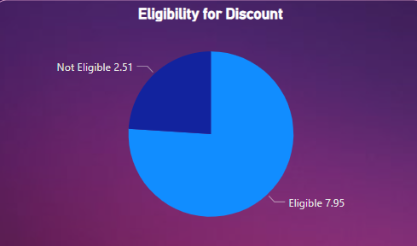
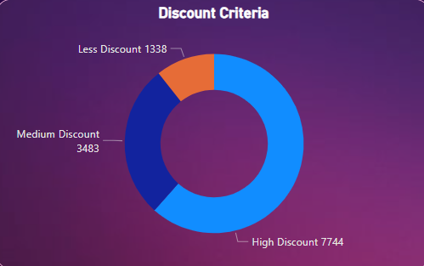
Discounts Part 1
Discount Criteria
The discount criteria was set according to the satisfaction scores by the patients.
Customer who gave scores less than 4 were eligible for less discount.
Who gave less than 7 were eligible for Medium discount.
High discount for those who gave more than 8 or above.
Discount Eligibility
Eligibility for the discounts was set according to the rating which patients gave
Patients who gave the ratings below 5 were not eligible for the discounts.
Patients who gave the rating more than 5 were only eligible for the discounts.

Slide 11

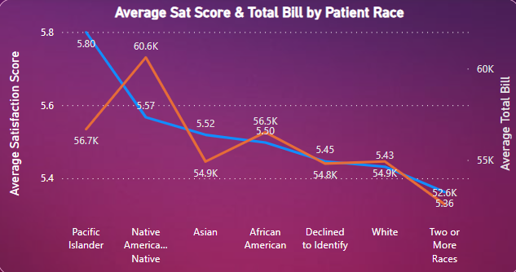
Discounts Part 2
Strategies
• Patient demographics analyzed for satisfaction scores and total bills.
• Informed development of adapted discount methods for diverse patient populations.
• Investigation of tiered discount structure's effectiveness in relation to satisfaction ratings and race.
• Line charts used to visualize discount strategies.
• Noteworthy pattern observed: "Native American/Alaska Native" demographic yields high satisfaction ratings and substantial total bills.
• Recommendation to consider offering targeted discounts to enhance engagement and satisfaction within this demographic.

Slide 12
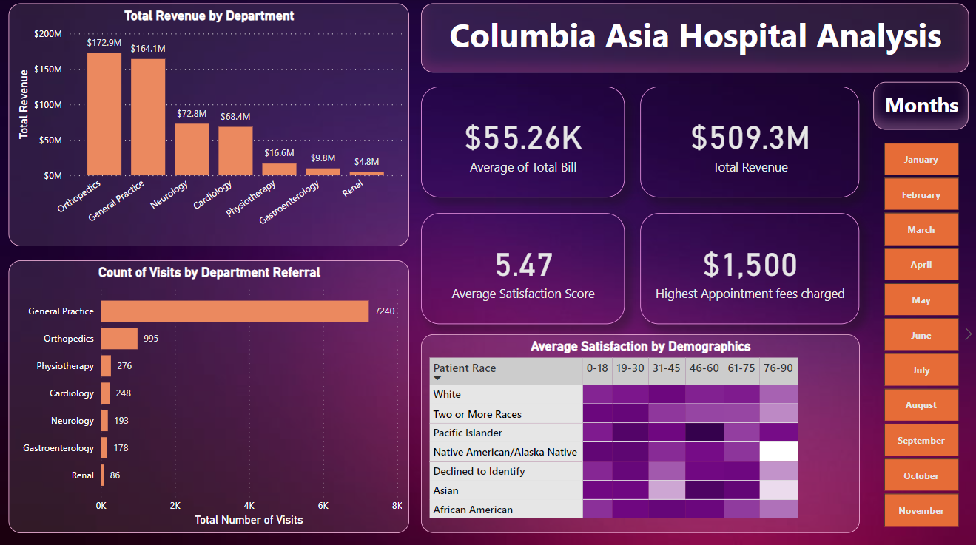
Dashboard and Visualizations
Main Tab
On this tab Hospital will be able to view all the metrics like number of daily visits, revenue produced, Satisfaction.
Added a Slicer of Months from which we will be able to see the results according the particular month.

Slide 13
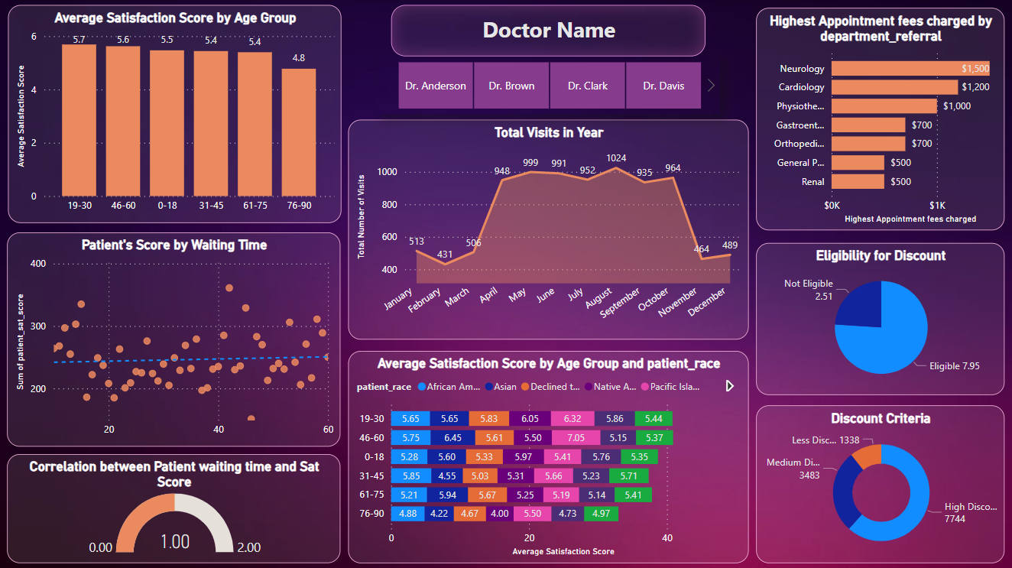
Dashboard and Visualizations
Doctor’s Tab
Individual doctor’s performance metrics will be visible here like customer satisfaction, number of patients visited, revenue generation.
I have added slicer of doctor’s name to view metrics as per every doctor.

Slide 14
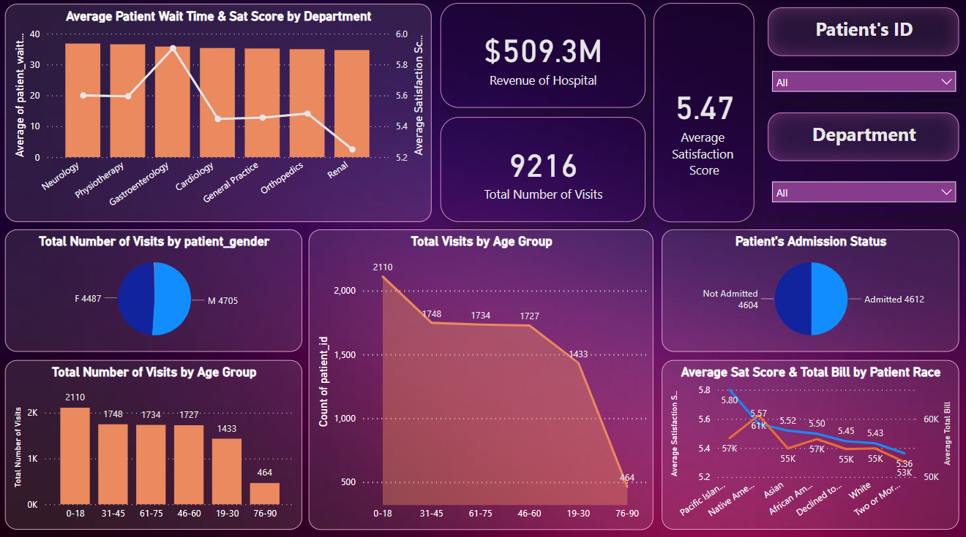
Dashboard and Visualizations
Patient’s Tab
This tab is built for viewing the customer’s profile which will be including some metrics like Department visited, age, race, gender, Total amount they have paid, etc.
I have added slicer of patient’s individual id to view profile as per every patient.

Slide 15

Thank You

